Slide 1
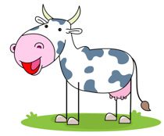
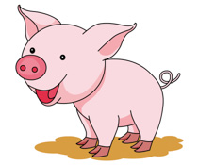
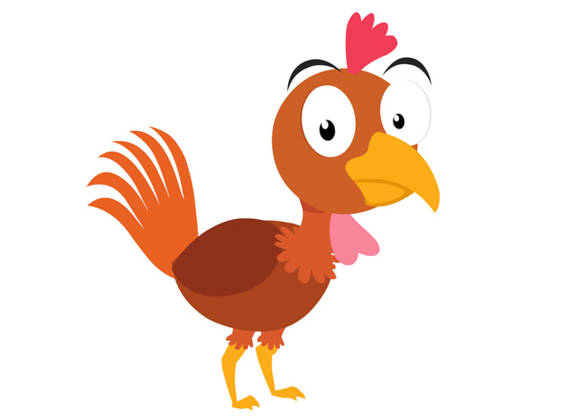
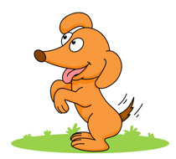
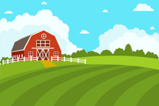
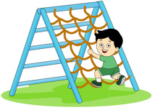
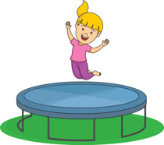
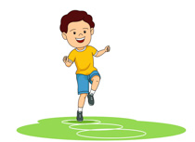
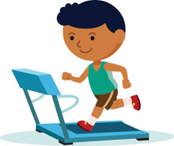
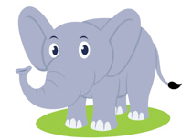
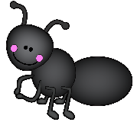
Picture Dictionary – Chicken, Pig, Cow
cow
pig
tail
chicken
dog
barn
climb
jump
play
run
big
small

Slide 2
Use the picture dictionary and write the word for each image.
_______________
_______________
__________
____________
_______________
___________
_____________
_______________
____________________
_________________
__________________
_______________

Slide 3
Find the words in the puzzle
small big run play
jump climb barn tail
dog chicken pig cow

Slide 4
Song: Old Macdonal Had a Farm
When you click on the following link, you will find flashcards, the lyrics to the song and the video.
https://supersimple.com/song/old-macdonald/
Draw a picture of three animals on your farm.

Slide 5
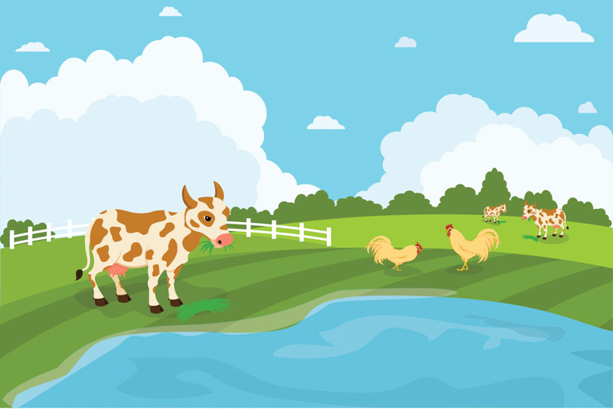
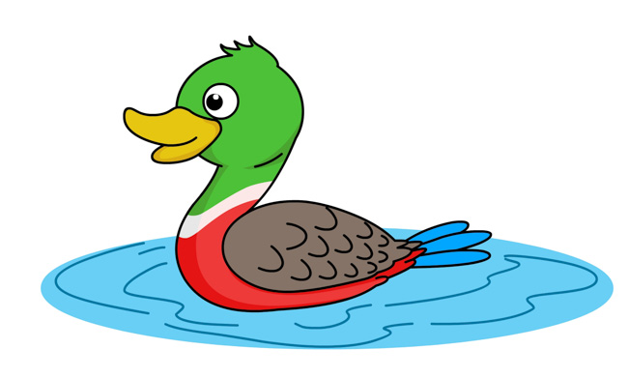
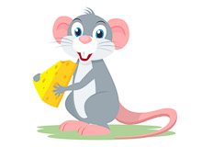
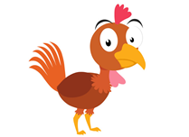
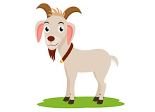
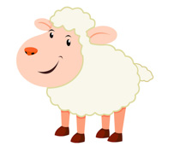
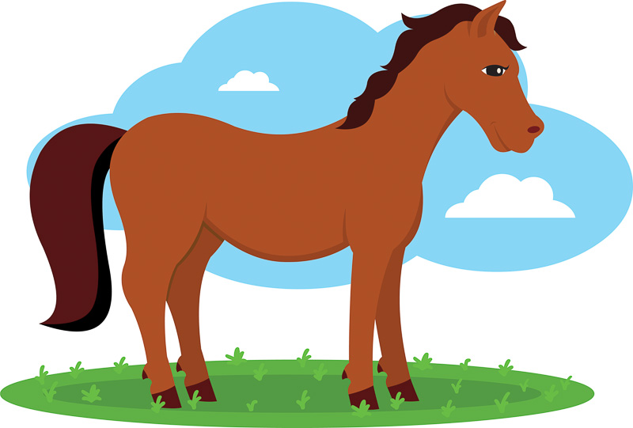
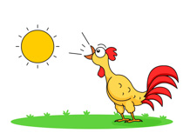
Song #2 – Picture Dictionary for “The Animals on the Farm”
https://supersimple.com/song/animals-on-the-farm/
cow - cows
pig - pigs
farm
duck- ducks
mouse - mice
chicken - chickens
goat - goats
sheep
horse - horses
rooster - roosters

