Slide 1
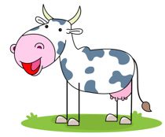
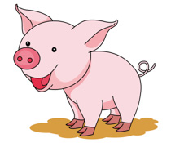
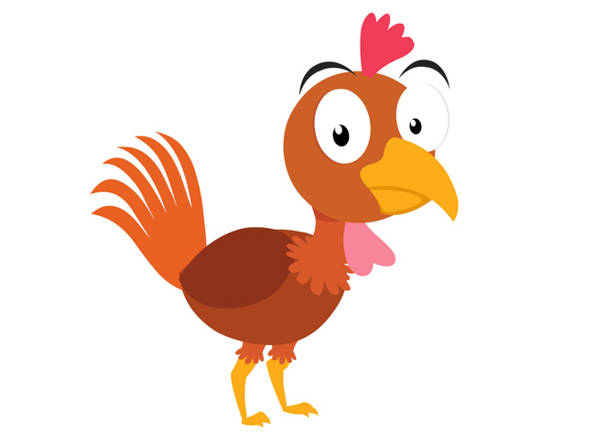
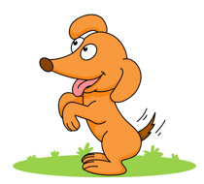
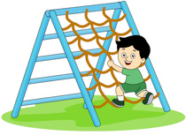
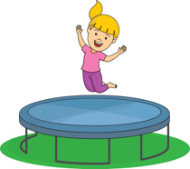
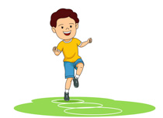
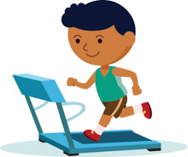
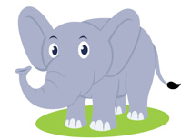
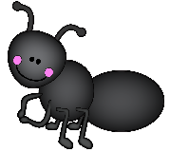
Picture Dictionary – Chicken, Pig, Cow
cow
pig
tail
chicken
dog
barn
climb
jump
play
run
big
small

Slide 2
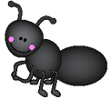
Use the picture dictionary and write the word for each image.
_______________
_______________
__________
____________
_______________
___________
_____________
_______________
____________________
_________________
__________________
_______________

Slide 3
Read the statement and draw a picture.
d
 | Draw your favourite farm animal.
Draw two big purple pigs.
Draw five small yellow chickens.
Draw three brown horses eating carrots.

Slide 4
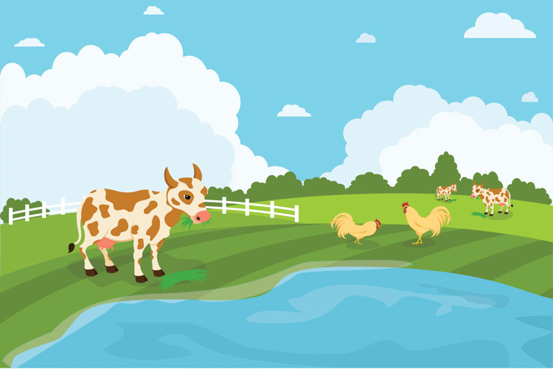
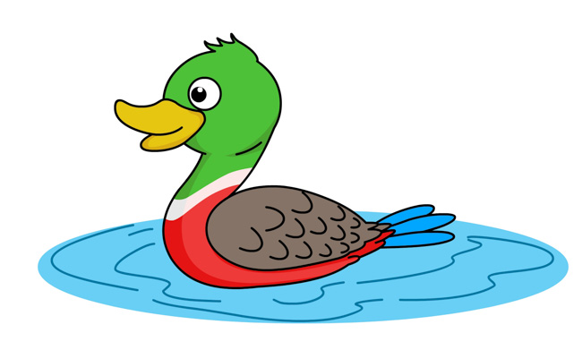
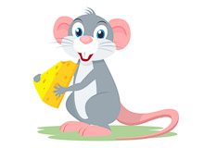
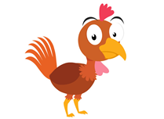
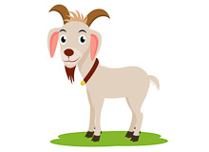
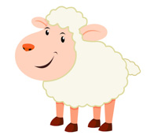
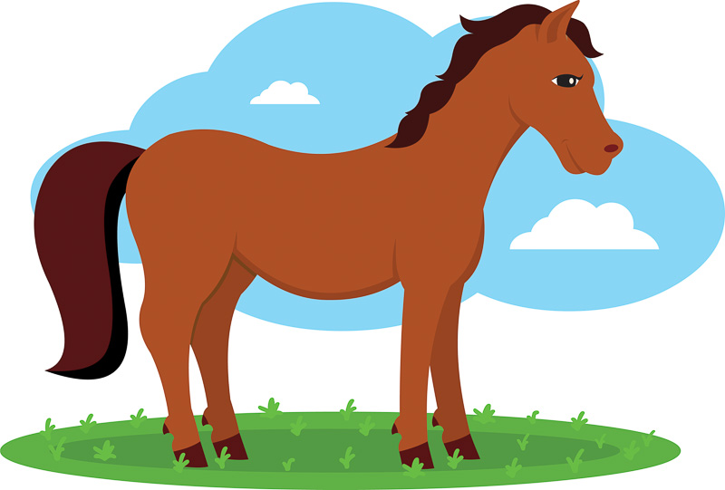
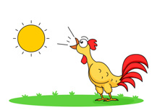
Song #2 – Picture Dictionary for “The Animals on the Farm”
https://supersimple.com/song/animals-on-the-farm/
cow - cows
pig - pigs
farm
duck- ducks
mouse - mice
chicken - chickens
goat - goats
sheep
horse - horses
rooster - roosters

Slide 5
Use the clues to complete the puzzle for the song – Animals on the Farm.
 |  |  |  | 1
 |  |  |  |  |  |  |  | 2
 |  |  |  |  |  |  | 3 |  |  |  | 4
 |  |  |  |  |  | 5
 |  |  | 6 | 7
 |  |  |  | 8 |  |  |  | 9
Across 3. What animal says "moo, moo, moo"? 6. What animal says "cluck, cluck, cluck"? 8. What animal says "bah, bah, bah"? | Down 1. What animal says "meh, meh, meh"? 2. What animal says "squeak, squeak, squeak"? 4. What animal says "cock-a-doodle-doo"? 5. What animal says "quack, quack, quack"? 7. What animal says "neigh, neigh, neigh"? 9. What animal says "oink, oink, oink"?

Slide 6
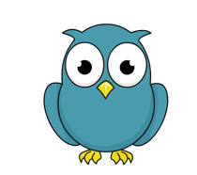
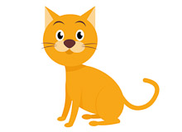
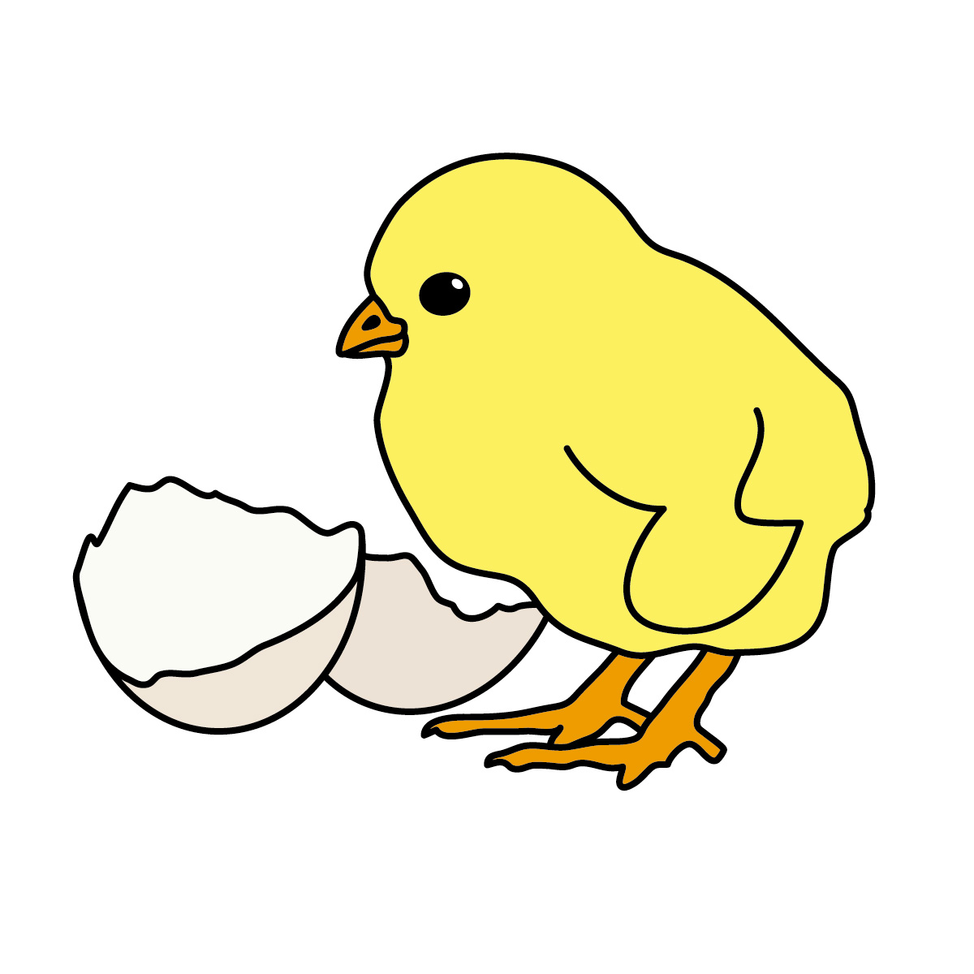
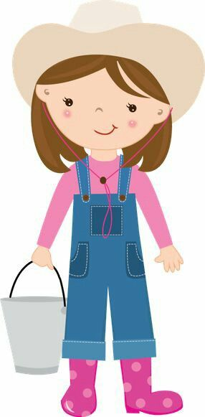
Bonus Activity – Watch the read-aloud video of Farmyard Beat by Lindsey Craig. The story stops at 2:44.
https://www.youtube.com/watch?v=mwRB566iyc0
Number the characters in order as they appear in the story.
owl
dog
cow
rooster
1
cat
chick- chicks
sheep
farmer

